Slide 1

Automate Database Backup Validation
Joe Gavin

Slide 2
Test-DbaLastBackup (dbatools)
Get latest backup information
Restores backup to destination as
dbatools-testrestore-<DatabaseName>
Run DBCC CHECKDB
Drop restored database
Repeat
Output results

Slide 3

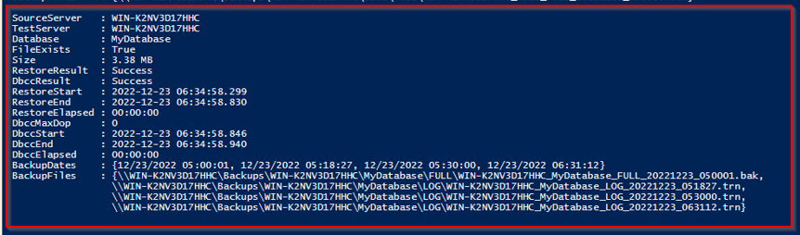
Run Test-DbaLastBackup

Slide 4
Assign Variables
<#
Script name: TestRestores.ps1
https://docs.dbatools.io/Test-DbaLastBackup
modules required: dbatools
#>
$Destination = "WIN-K2NV3D17HHC"
$WorkDir = "C:\BackupValidation"
$OutFile = "$WorkDir\BackupValidation.csv"
$PSEmailServer = 'smtp.mymailserver.com'
$SqlServers = Get-Content "$WorkDir\servers.txt" | Sort-Object # ordered list of sql server names in text file

Slide 5
Loop Through List of Servers
# cd to working directory
Set-Location $WorkDir
# delete old outfiles
If (Test-Path "$OutFile"){Remove-Item "$OutFile"}
# loop thru servers in $SqlServers array
Foreach ($SqlServer in $SqlServers) {
Test-DbaLastBackup -SqlInstance $SqlServer -Destination $Destination | `
Select-Object SourceServer,Database,FileExists,Size,RestoreResult,RestoreElapsed,DbccResult, `
# https://www.millersystems.com/powershell-exporting-multi-valued-attributes-via-export-csv-cmdlet/
@{Name='BackupFiles';Expression={[string]::join("`n", ($_.BackupFiles))}} | `
Export-Csv -Path $OutFile -Append -NoTypeInformation
}

Slide 6
Email Output File as Attachment
# email attachements
$Attachments = @("$OutFile")
Send-MailMessage -To "dba@mycompany.com" -From "testrestores@mycompany.com" -Subject "Test Restores Report" -Attachments $Attachments

Slide 7
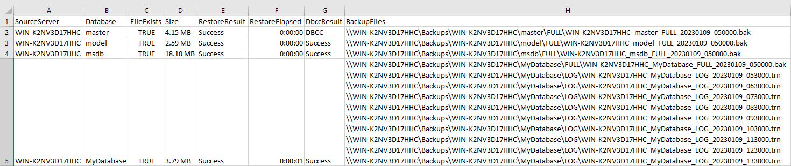
Output File

Slide 8
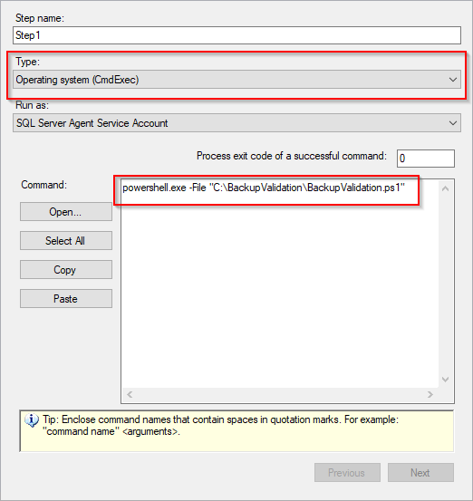
SQL Agent Job
Create a SQL Agent Job of Type Operating system (CmdExec) to call the script and run it on a schedule

Slide 9
Optional Parameters (partial list)
-Database -ExcludeDatabase
-IgnoreDiffBackup -IgnoreLogBackup
-NoCheck -NoDrop
-Prefix -VerifyOnly

Slide 10


